Slide 1

Introduction
Group member:
Chen Li
Mingyu Chen
Kewei SHu
http://www.wp-tech.net/wptech/wp-content/uploads/2016/07/JQuery_logo.png
EG
Internet programming
#<number>

Slide 2
Features
Simple syntax for:
      Selecting DOM elements
      Creating simple animations
      Handle events
      …
EG
Internet programming
#<number>

Slide 3
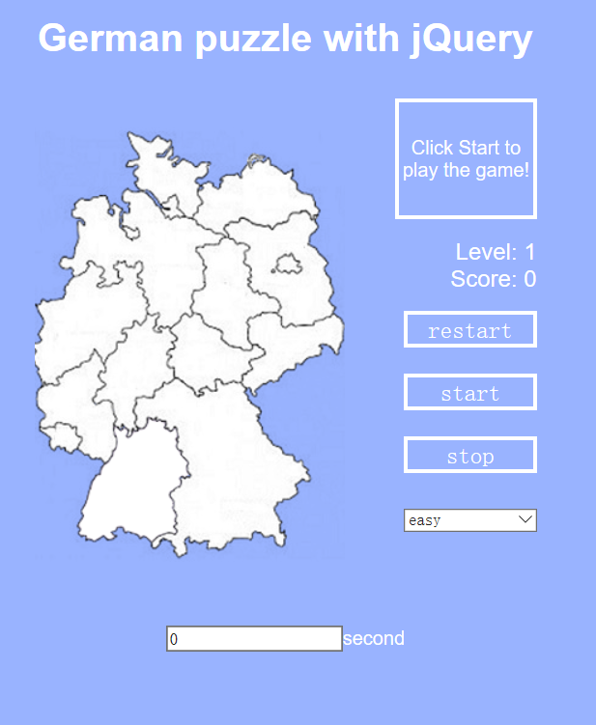
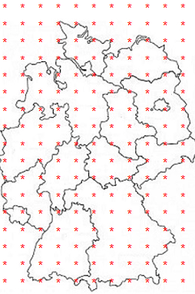
Our application
Use table to record the position of click
EG
Internet programming
#<number>

Slide 4
Structure
class="Schleswig-Holstein"
(2,4) (2,5)
(3,4) (3,5) (3,6) (3,7)
(4,5)(4,6)
class="Baden-Wuerttemberg"
(13,4) (13,5)
(14,4) (14,5) (14,6)
(15,3) (15,4) (15,5)
(16,3) (16,4) (16,5)
(17,3)
EG
Internet programming
#<number>

Slide 5
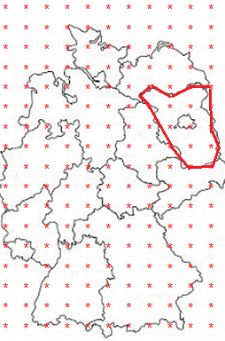
Structure
Setting the points in this area
$(".Brandenburg").click(function(){}
EG
Internet programming
#<number>

Slide 6
Demo
Show the functions of jQuery in our web!
LGXZ
Cleaning Agent Project
#<number>

Slide 7
Why jQuery
the manipulation of element is easier
JavaScript
var element=document.getElementById("header").value;
jQuery
var element = $(“#header”).val() ;
EG
#<number>

Slide 8
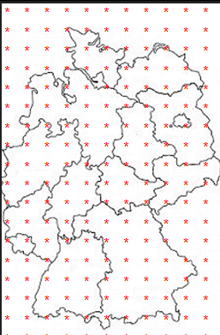
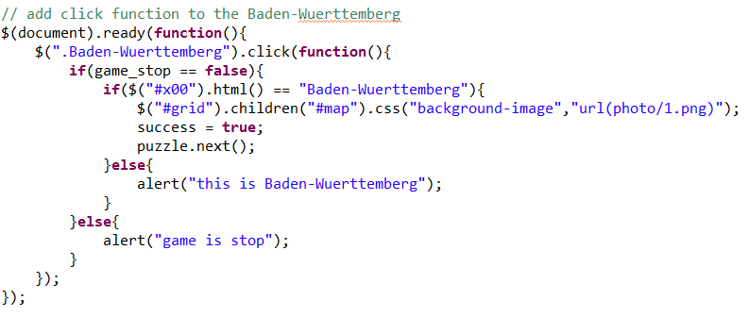
Why jQuery
the manipulation of element is easier
EG
#<number>

Slide 9
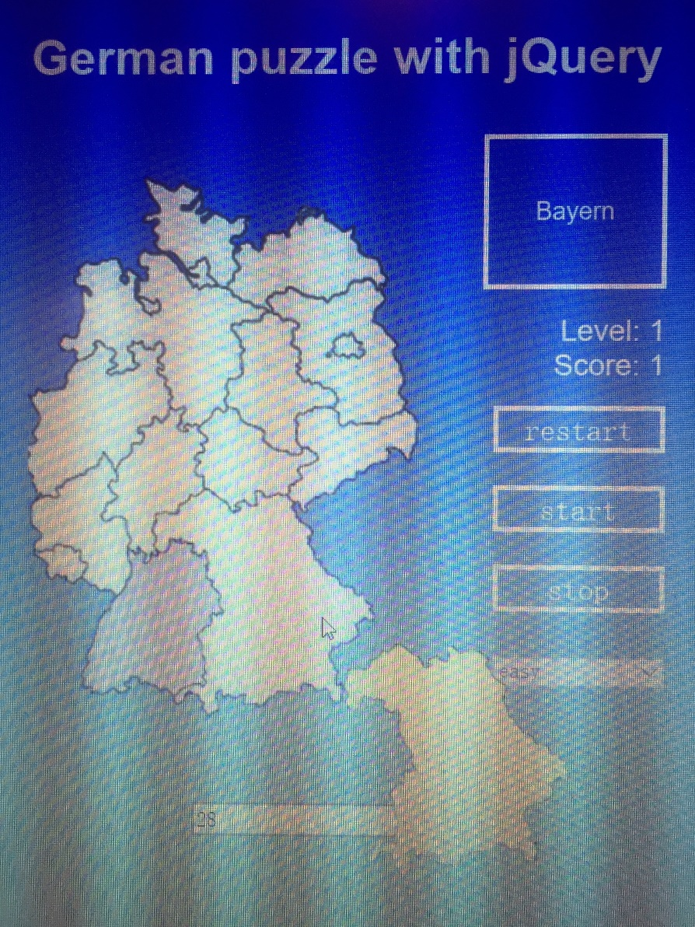
Why jQuery
cool effect
event: MouseMove()
EG
#<number>

Slide 10
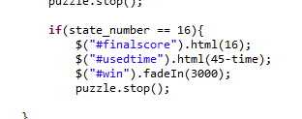
Why jQuery
cool animation
$(selector).fadeIn(speed,callback);
EG
#<number>

Slide 11
Why jQuery
Chaining
EG
#<number>

Slide 12

Why jQuery
greater browser compatibility
https://baike.baidu.com/pic/ajax/8425/0/c995d143ad4bd113fa64e1fb5bafa40f4afb0549?fr=lemma&ct=single#aid=0&pic=c995d143ad4bd113fa64e1fb5bafa40f4afb0549
EG
#<number>

Slide 13
jQuery
Thanks for watching!
LGXZ
Cleaning Agent Project
#<number>

